Slide 1

Smart Door Lock System Leveraging IoT for Enhanced Home Security
Presented by
Sudhakar Hanumanth(Leader)-316802
Joshua Porunnedath Biju(Developer)-316821
Joyel Porunnedath Biju(Developer)-316820
Shravanthi Keshavamurthy(Developer)-319517
Zishnu Viknesh Shivakumar(Editor)-316777

Slide 2
Why Smart Door Lock System?

Slide 3
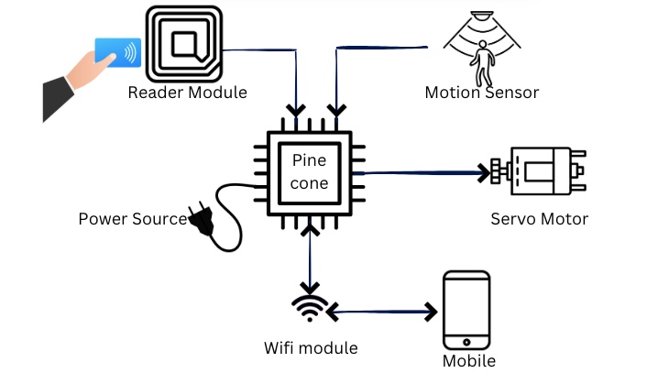
Data Flow Diagram

Slide 4
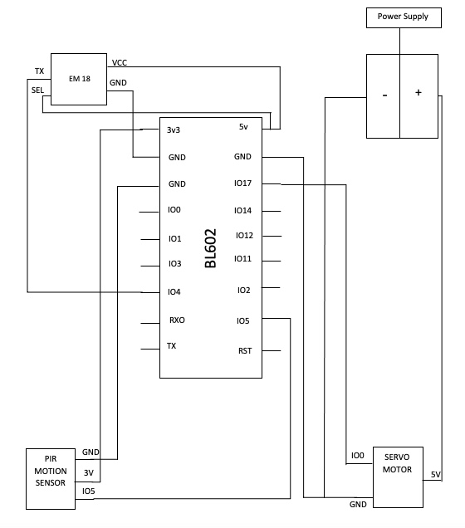
Pin Diagram

Slide 5
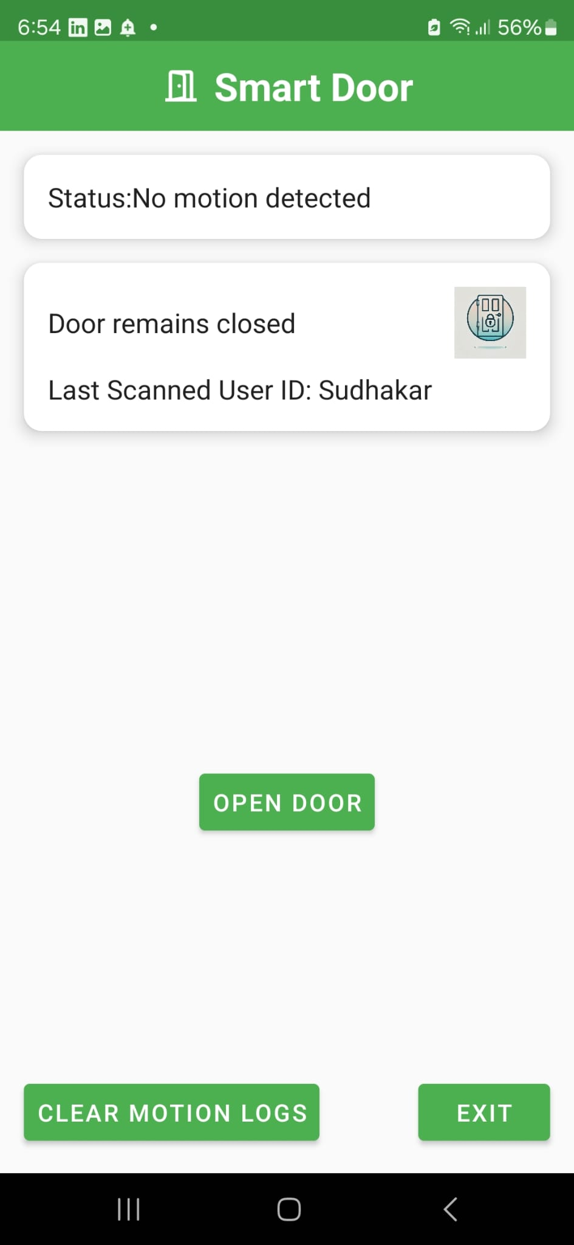
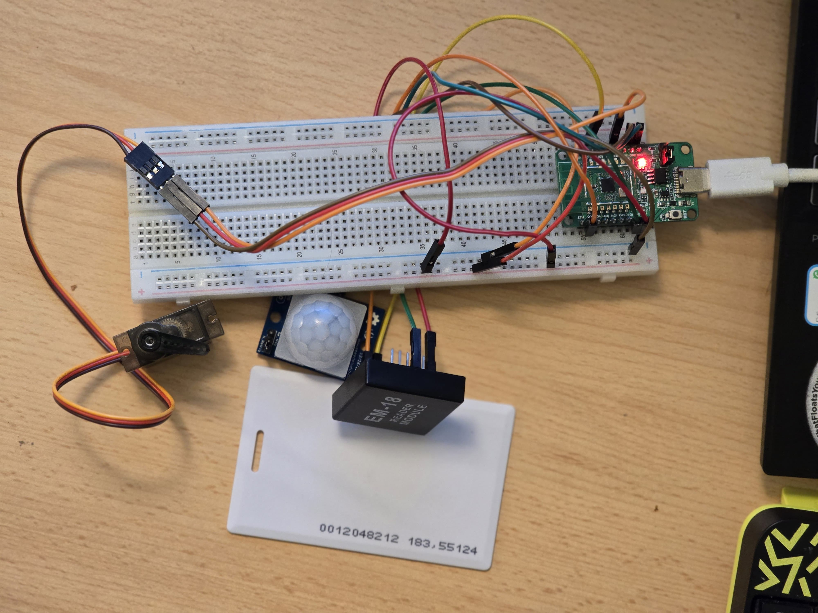
Components of the Smart System
Hardware
Software

Slide 6
Prototype Demonstration

Slide 7
Achievements

Slide 8
Conclusion

Slide 9
Any Questions ?

Slide 10
Thank You

